Slide 1

Smart Dustbin

Slide 2


Name: MD Rafi Alam
ID:2022100000092
Name: MD Sakib Khan
ID:2022100000099
Course Title: Introduction to Embedded Systems Lab
Course Code: CSE 382
Sec:02
Faculty: Mustavi Ibne Masum (MUM)

Slide 3
Project Overview
Project Idea:
The smart dustbin projects main idea is to reduce contact with the waste bin by automated system using sensors, motors etc. The project will showcase a bin which will detect level of waste using sensors and show real time data in a LCD. When someone approaches towards the bin lid will open automatically by using motors and sensors. At full condition the lid will not gonna open automatically, it can only be opened by a push switch for a certain period of time and a led is there incase LCD is not in working mode.

Slide 4
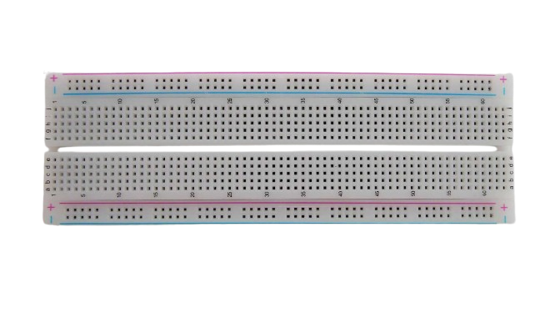
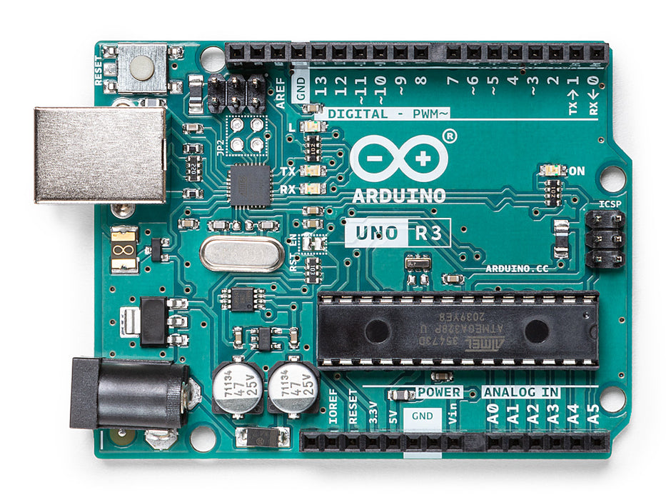
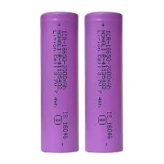
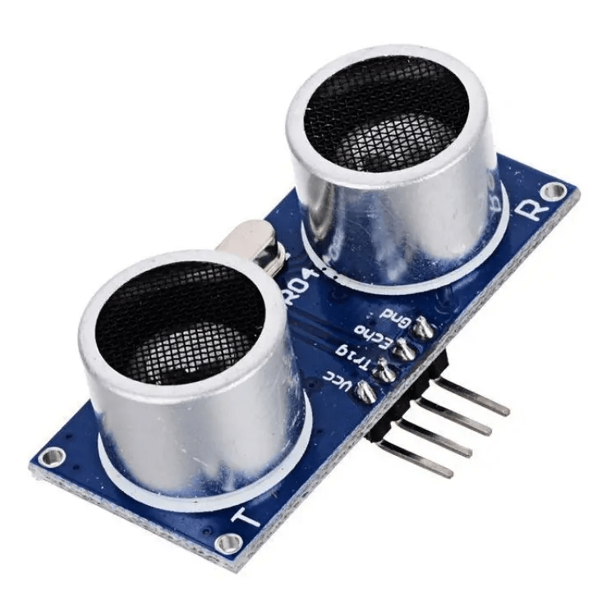
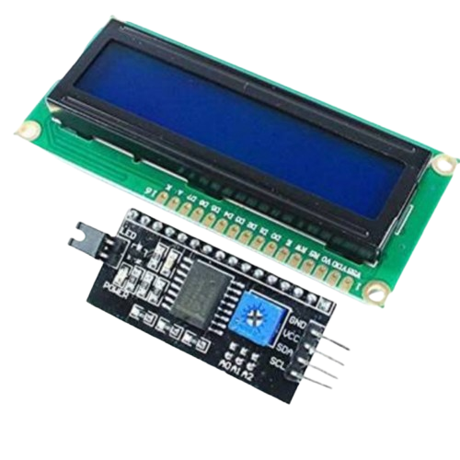
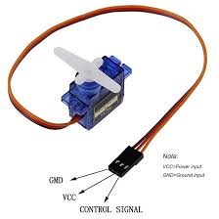
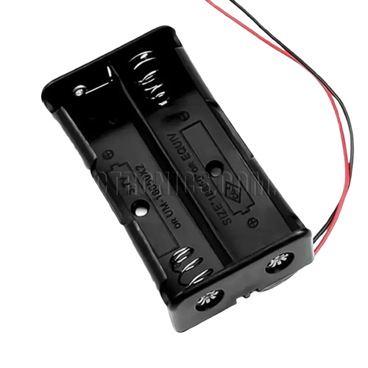

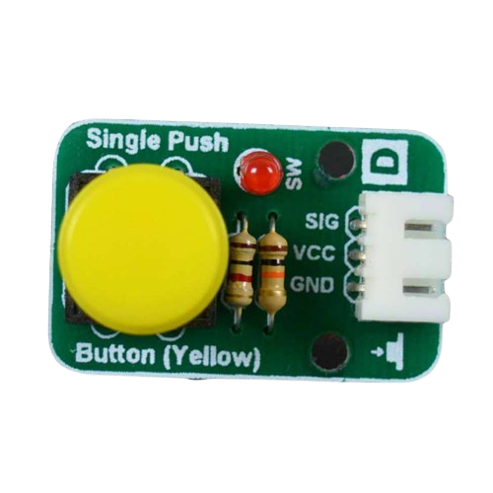
Sensors and Equipment
Breadboard
Arduino Uno
Ultrasonic Sensor (HC-SR04)
Battery
Lcd Display I2C
With Driver
Servo Motor
18650 Battery case holder
Jumper Wires
Single Push Switch module

Slide 5
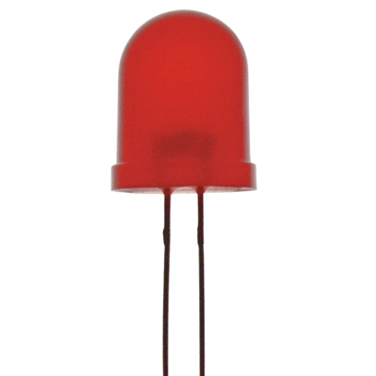

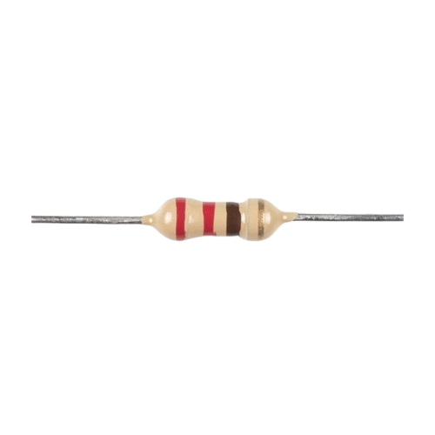
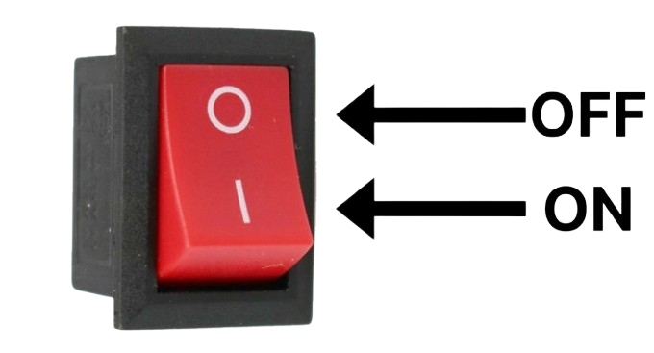

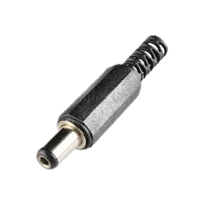
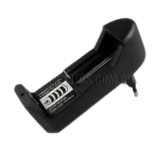
Sensors and Equipment
Red Led
Hinges
Resistor
On/off Switch
Pvc Board
Male Jack
18650 Battery Charger

Slide 6
Individual & Total Cost
SN | Component | Quantity | Rate | Price
1 | Arduino Uno (DIP) | 1 | 700 | 700
2 | Ultrasonic Sensor (HC-SR04) | 4 | 100 | 400
3 | Servo Motor | 2 | 150 | 300
4 | Breadboard | 1 | 110 | 110
5 | Battery | 2 | 100 | 200
6 | Jumper Wires | 2 | 120 | 240
7 | 18650 Battery case holder | 1 | 50 | 50
8 | Single Push Switch module | 1 | 50 | 50
9 | On/off Switch | 1 | 10 | 10
10 | Lcd Display I2C With Driver | 1 | 340 | 340
11 | Pvc Board | 1 | 250 | 250

Slide 7
Individual & Total Cost
12 | Red Led | 1 | 5 | 5
13 | Resistor | 1 | 2 | 2
14 | Male Jack | 1 | 15 | 15
15 | 18650 Battery Charger | 1 | 120 | 120
16 | Some Extra instrument |  |  | 80
17 | Hinges | 2 | 20 | 40
TOTAL |  |  |  | 2912
Md Rafi Alam |  | 1450
Md Sakib Khan |  | 1462

Slide 8
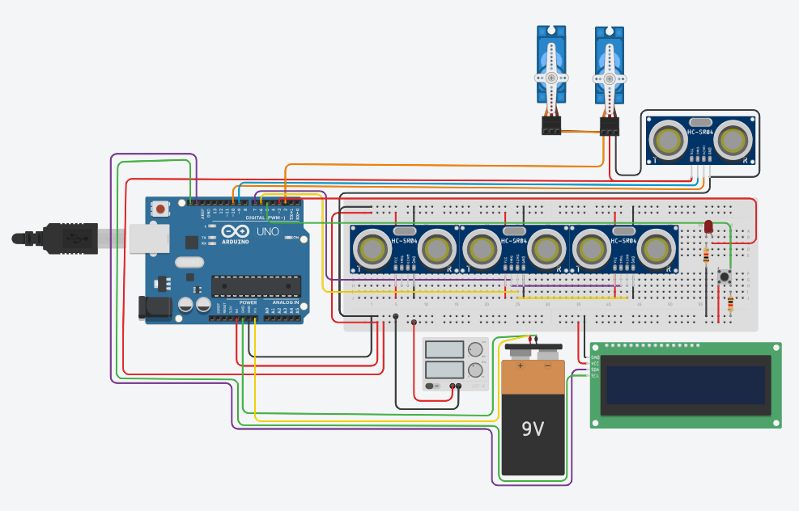
Circuit Diagram
https://www.tinkercad.com/things/6PTf9wDQI4K-smart-dustbin

Slide 9
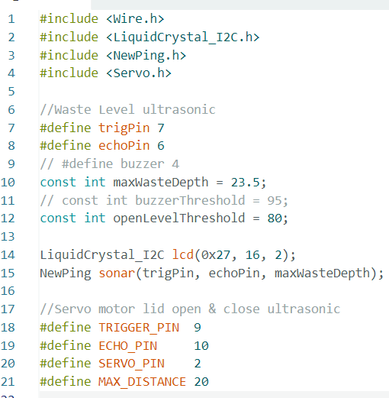
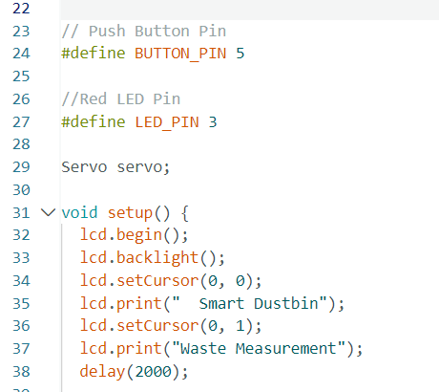
Project Code

Slide 10
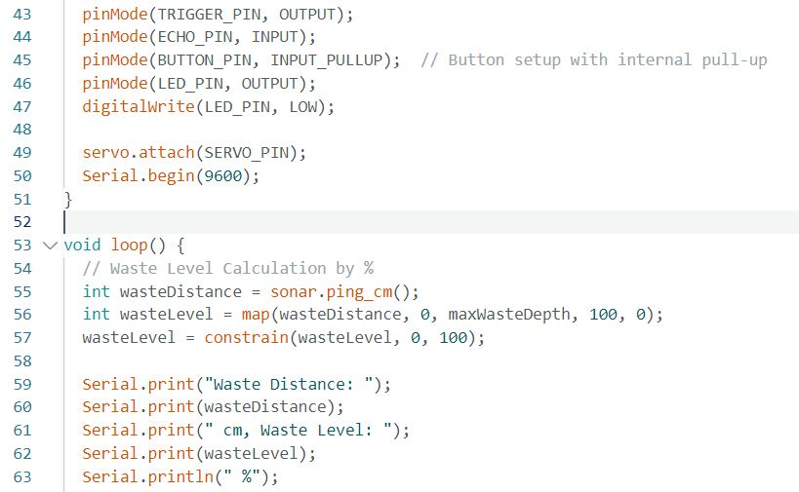
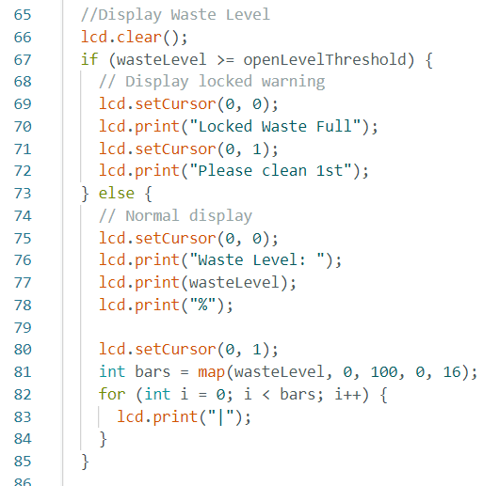
Project Code

Slide 11
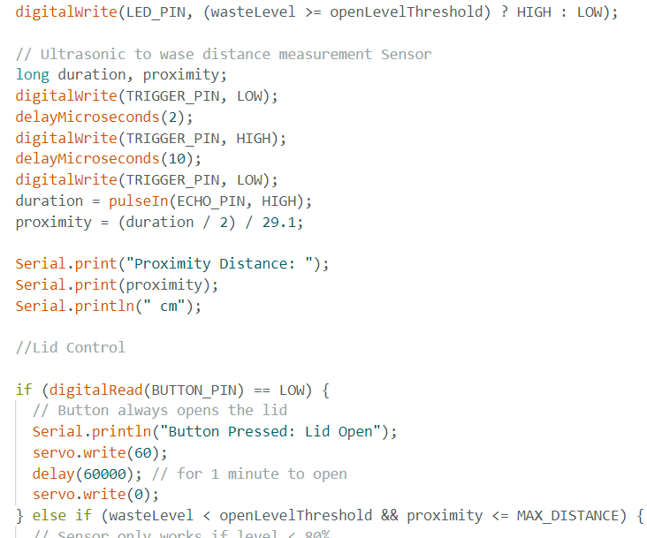
Project Code

Slide 12
Project Code

Slide 13
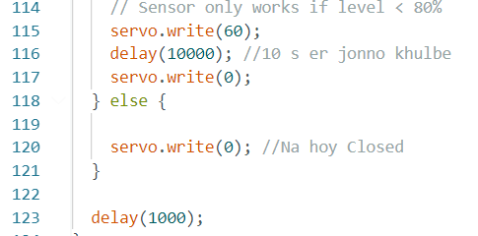
Project Code

Slide 14
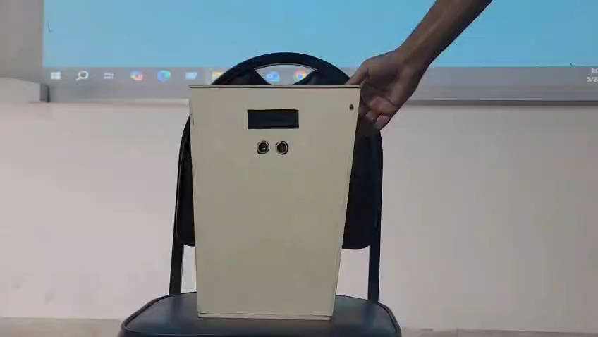
Project Video

Slide 15
Thank You

